Slide 1
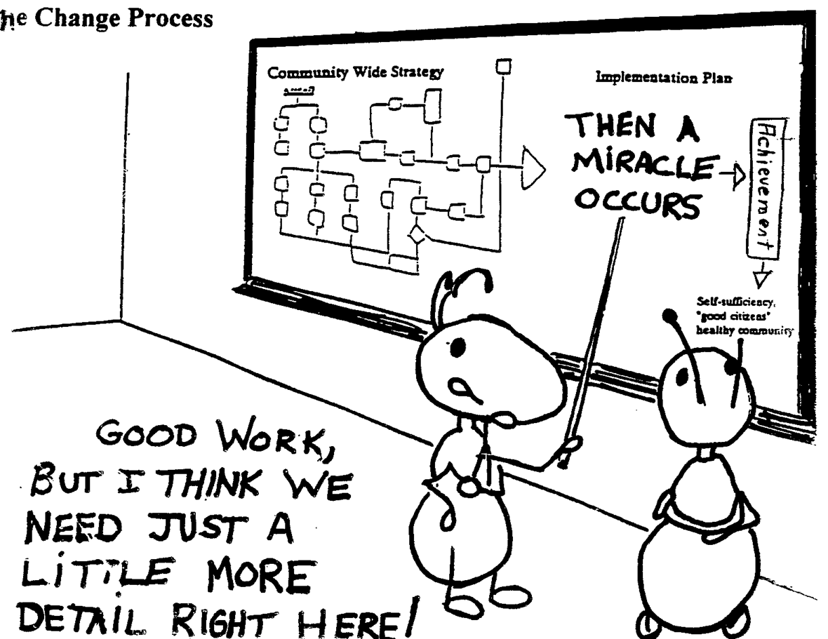
Digital Project Stages: Analysis
Notes:
Oftentimes researchers see technology as a magic elixir and it clouds the process of doing a digital project and the time that it takes. Though the stages of a digital project are the same as a traditional research project, it’s good to think about these stages one at a time and consider the 3 aspects in each stage.

Slide 2
Three Stages of Digital Project
Collection of Data
Analysis and Processing of that Data
Publication of the Results

Slide 3
Stage Two: Analysis
Analysis = finding patterns and/or outliers in your data + making an argument about them
As we can see from the gun violence examples, analysis often starts as we begin shaping our data
Analysis is nothing new to a humanist: we are are just swapping out flash cards and sticky notes for spreads and databases

Slide 4
2 Common Steps In Translation
1) standardization - process of deciding upon one way of representing a piece of information that appears in the source in a number of different ways
2) classification - process of grouping together information (‘strings’) according to some theoretical, empirical or entirely arbitrary scheme
Notes:
Standardization and classification are 2 techniques that we can use to structure our data in a way the computer can understand and will improve our retrieval and display of our information. Let’s take a look at these techniques in practice.

Slide 5
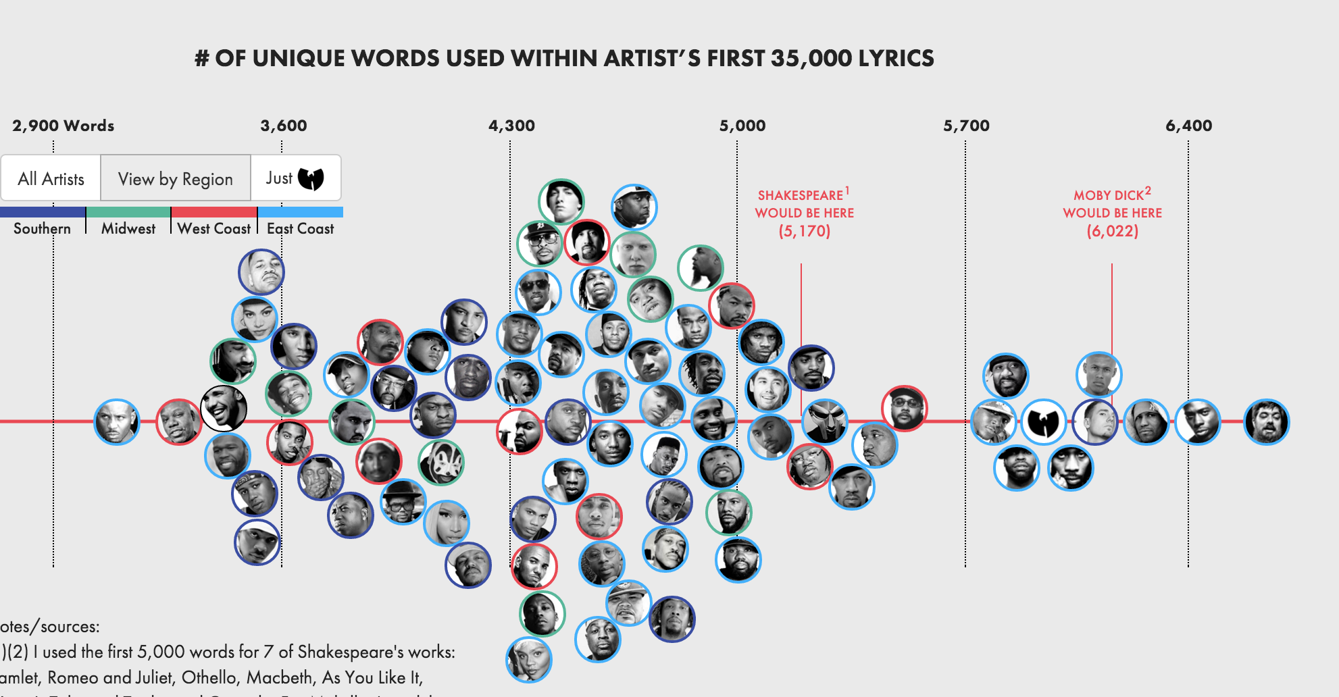
Examining Steps of Translation
http://poly-graph.co/vocabulary.html
Notes:
1) Structure:
Rappers by name, lyric count, region, wutang affiliation – could have been (album sales, # of albums, producers worked with)
2) Analyze:
rappers by unique lyrics
3) Communicate
compare lyric uniqueness by rapper, region, and affiliation to wutang

Slide 6
Identify Standardization And Classification ?
id | Rapper | Region | wutang? | cluster | Words
rakim | Rakim (including Eric B. & Rakim | east | nowutang | 5 | 4,612
dmx | DMX | east | nowutang | 1 | 3,214
too-short | Too Short | west | nowutang | 1 | 3,391
gza | GZA (only solo albums | east | wutang | 7 | 6,426
drake | Drake | other | nowutang | 1 | 3,522
bone-thugs | Bone Thugs-n-Harmony | midwest | nowutang | 1 | 3,547
master-p | Master P | south | nowutang | 2 | 3,612
Notes:
Here is the data behind the rapper lyric visualization. Can you identify the occurrences of standardization and classification.

Slide 7
Red = Standardization Orange = Classification
id | rapper | region | wutang? | cluster | words
rakim | Rakim (including Eric B. & Rakim | east | nowutang | 5 | 4,612
dmx | DMX | east | nowutang | 1 | 3,214
too-short | Too Short | west | nowutang | 1 | 3,391
gza | GZA (only solo albums | east | wutang | 7 | 6,426
drake | Drake | other | nowutang | 1 | 3,522
bone-thugs | Bone Thugs-n-Harmony | midwest | nowutang | 1 | 3,547
master-p | Master P | south | nowutang | 2 | 3,612
Notes:
The id is standardized for the computers sake. Computers don’t like spaces and will do weird things with ordering when capital letters are present. What’s important is the researcher separated the id the computer will use to identify each artist from the column that will be used to display the name. This way the researcher optimizes the computer’s retrieval of this data while also making it human readable in the visualization.
Classification here is also used to help the computer optimize retrieval and presentation of the information. Here we use classification to help us make some key comparisons in our data, namely how is lyric uniqueness is effected region and just how lyrically talented the wutang clan was.

Slide 8
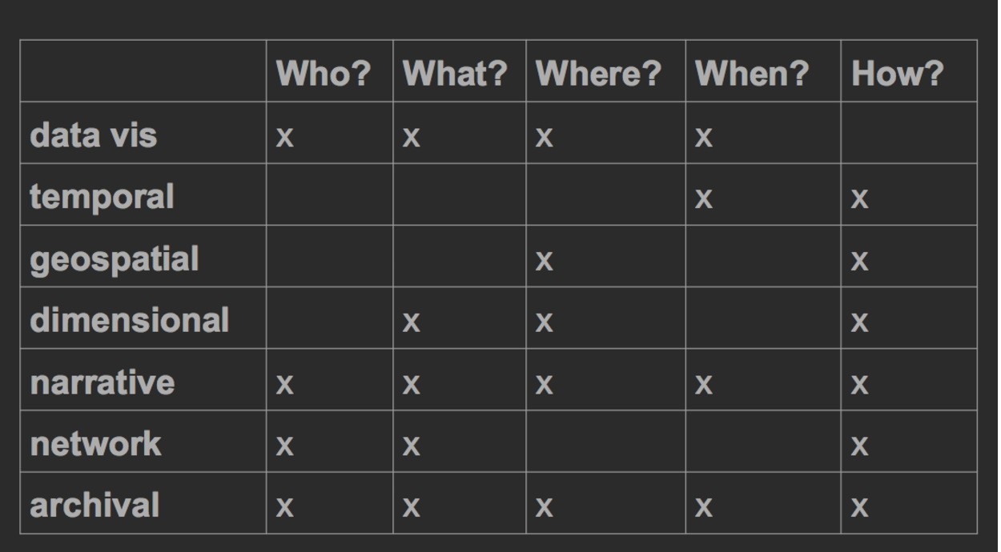
Analysis Drives Project Type

